Slide 1


T E A M
R O C K E T
C O N S U L T I N G
F I R M
ALVIN VICTOR & HANNAH MOY

Slide 2

Project Outline
Goal:
Predict the outcome of Pokemon battles to determine which Pokemon(s) Team Rocket should have on roster to increase a “favorable” outcome
Steps:
Data Cleaning
Feature Engineering
Machine Learning Model
Some Questions to Consider:
What Pokemon stats (attack, defense, speed etc) have the highest correlation with winning battles?
How many different Type 1 Pokemon are there?
What model is the best for Team Rocket?

Slide 3
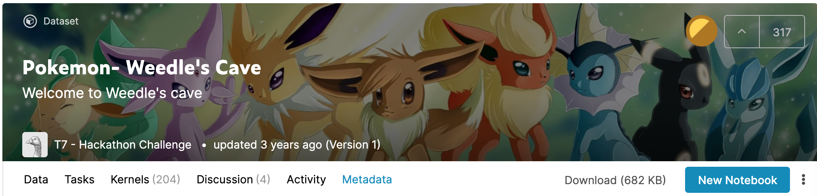
Data Set
Kaggle - Weedle’s Cave
https://www.kaggle.com/terminus7/pokemon-challenge/metadata

Slide 4
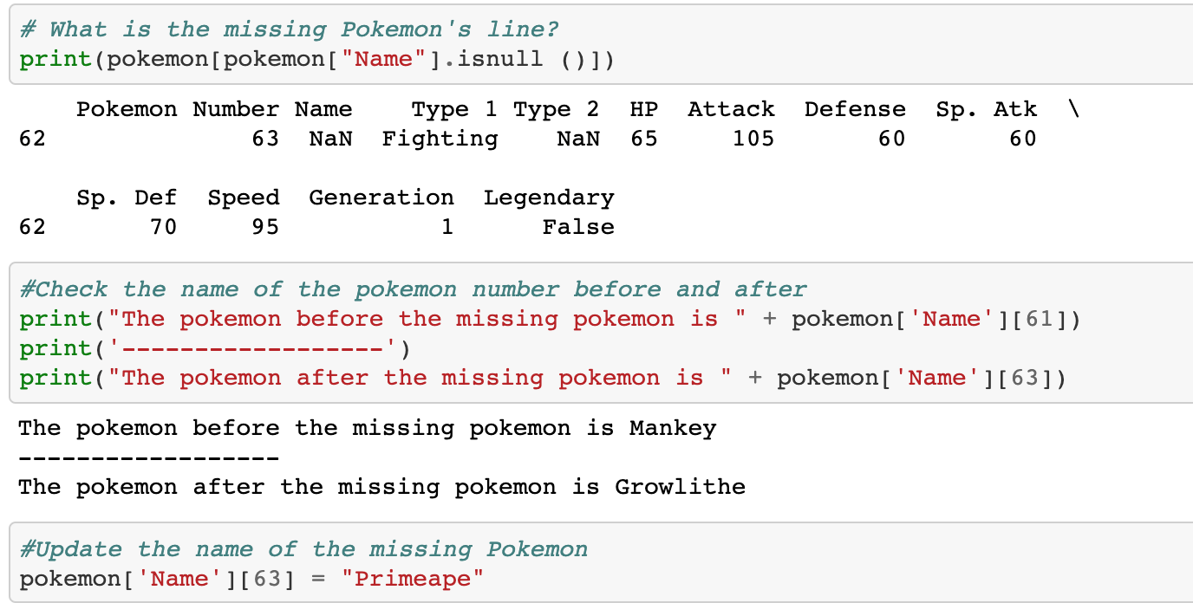
Identifying Missing Pokemon
Notes:
Data Cleaning - Determined Primeape based on evolution stage

Slide 5
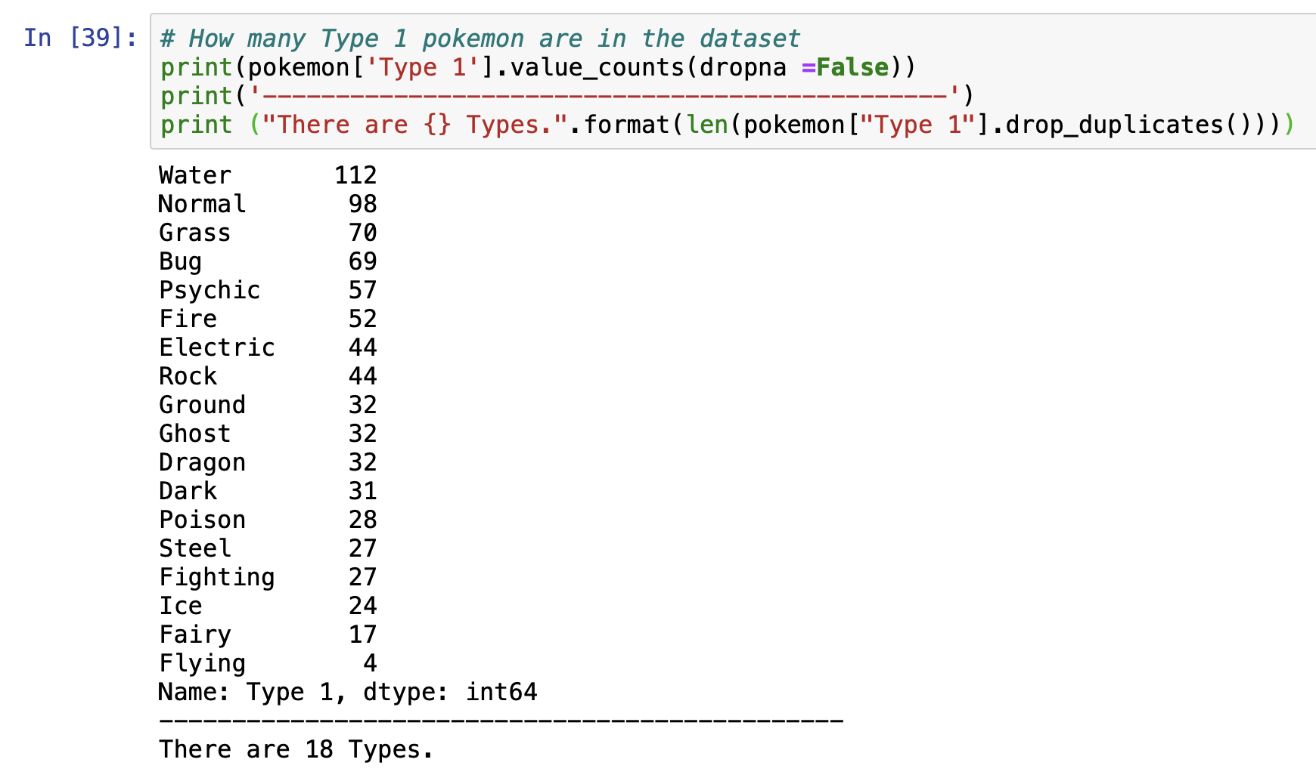
How Many Unique Type One Pokemon Are There?
Notes:
Data Exploration - What are the type 1 pokemon?

Slide 6
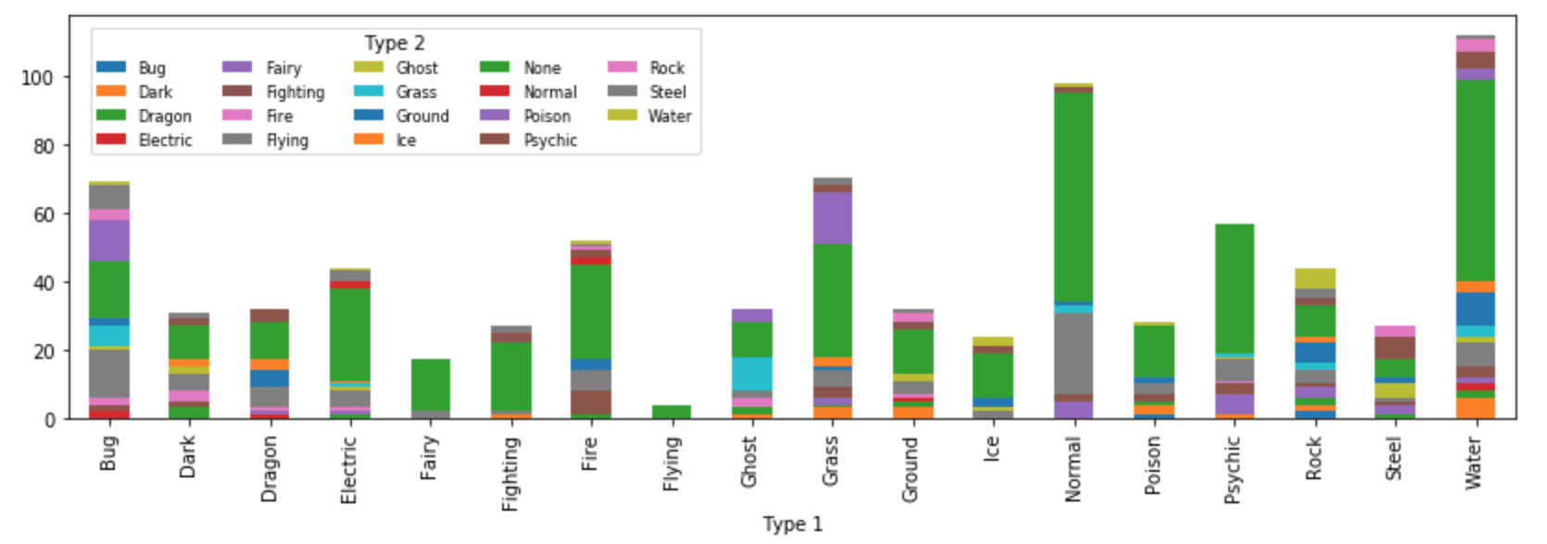
Type Combinations
Notes:
Data Exploration - Visualizing the Type 1 & Type 2 combos.
Water has the most diversity. Flying has the least.

Slide 7
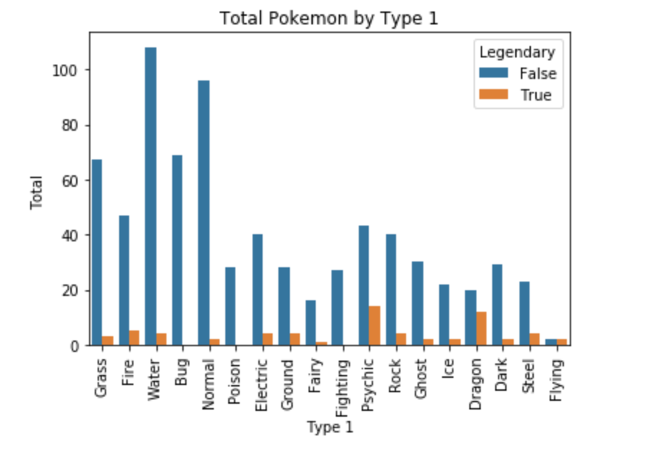
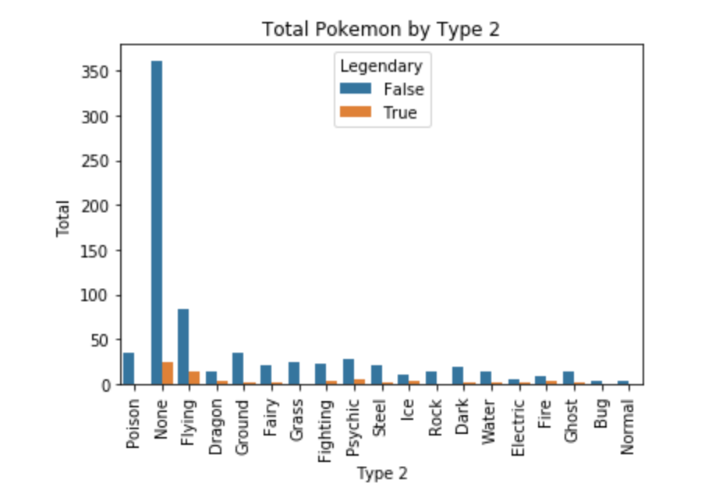
Identifying Legendary Pokemon
Notes:
Data Exploration - Identifying Legendary Pokemon & their types.
Most common for Legendary Pokemon to be a Psychic or Dragon type
Not common for Legendary Pokemon to have a second type

Slide 8
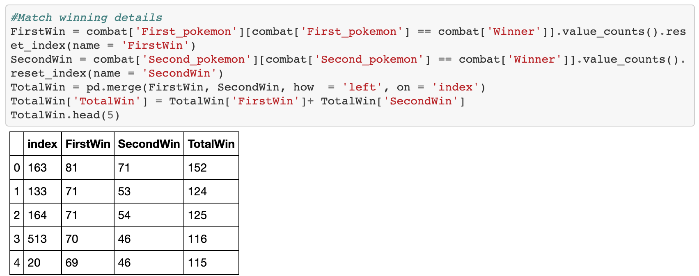
Feature Engineering - Finding the Total Wins

Slide 9
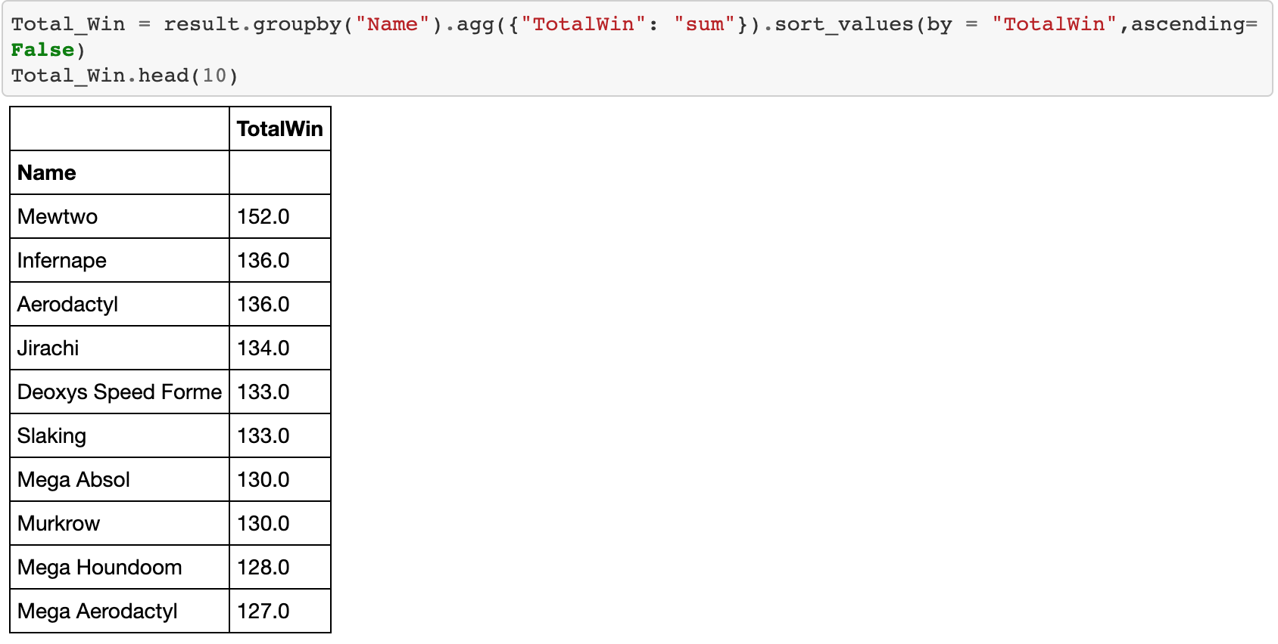
Feature Engineering - Finding the Total Wins Cont.

Slide 10
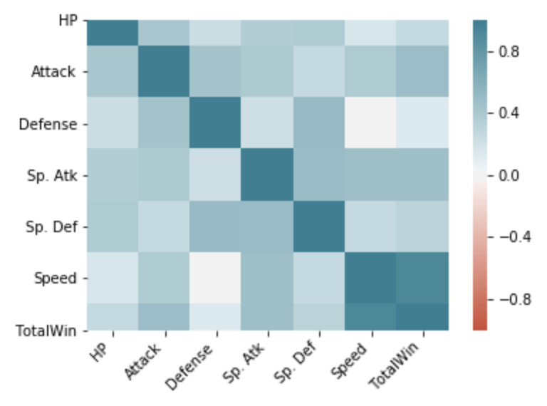
Correlation Matrix of All Attributes
Notes:
Speed is the biggest attribute for Total Wins.
Defense is the lowest attribute for Total Wins.

Slide 11
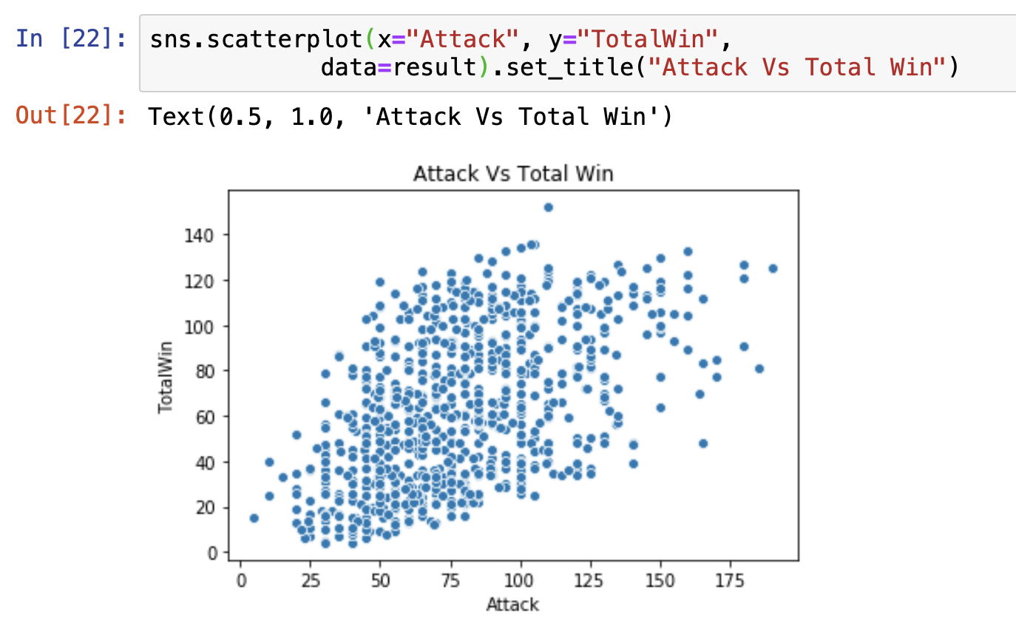
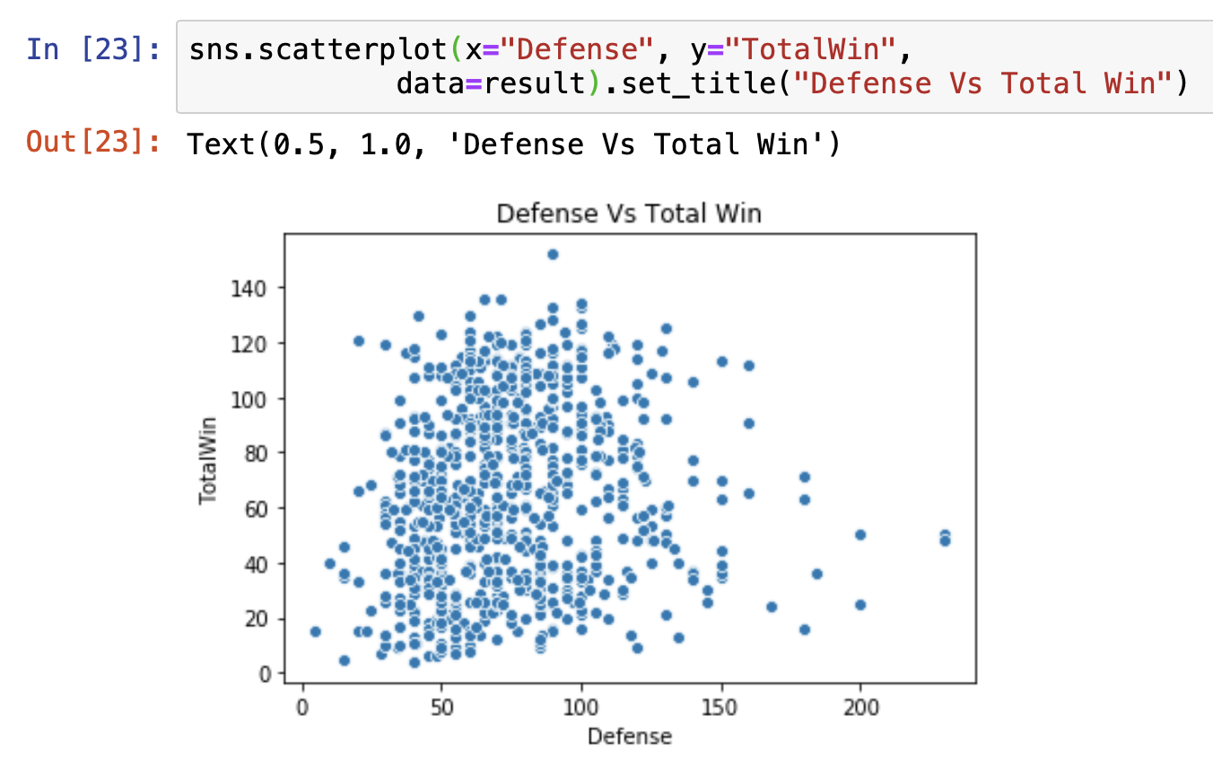
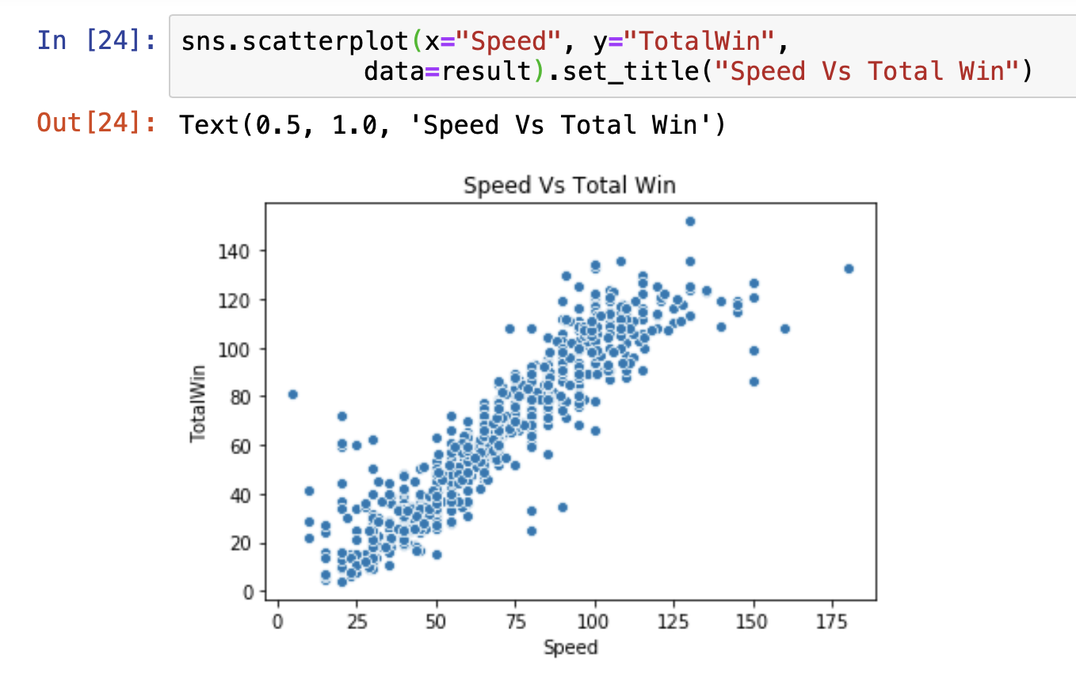
Visualizing Linear Regression
Notes:
Used with regplot
Just like the Correlation Matrix, you can see a clear relationship between Speed & Total Wins (unlike Defense & Attack)

Slide 12

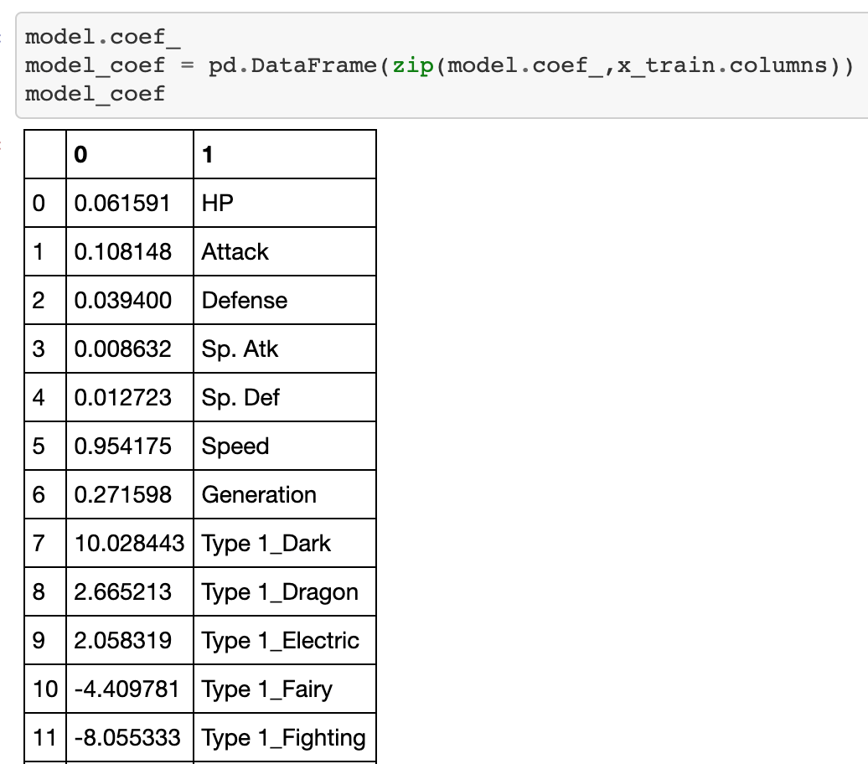
Linear Regression Coefficient
Recommend: Sableye
Type: Dark, Ghost
Speed: 50
Attack: 75
Defense: 75
Notes:
Shows the weight of each attribute.
“Dark (type) The Dark type was introduced in the second generation of Pokémon games as a measure to balance the types. In particular, its resistance to Psychic cut down that type's advantage by a long way. When paired with the Ghost type it was the only type combination to have no weaknesses prior to Gen 6.” For example: Sableye is a dark & ghost pokemon introduced in gen 3

Slide 13
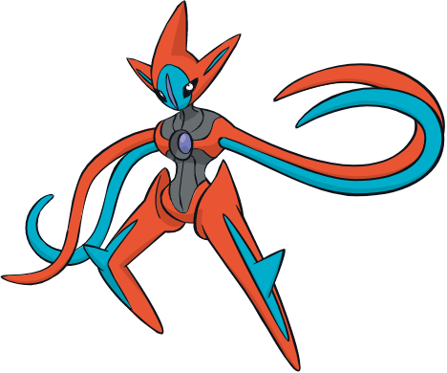
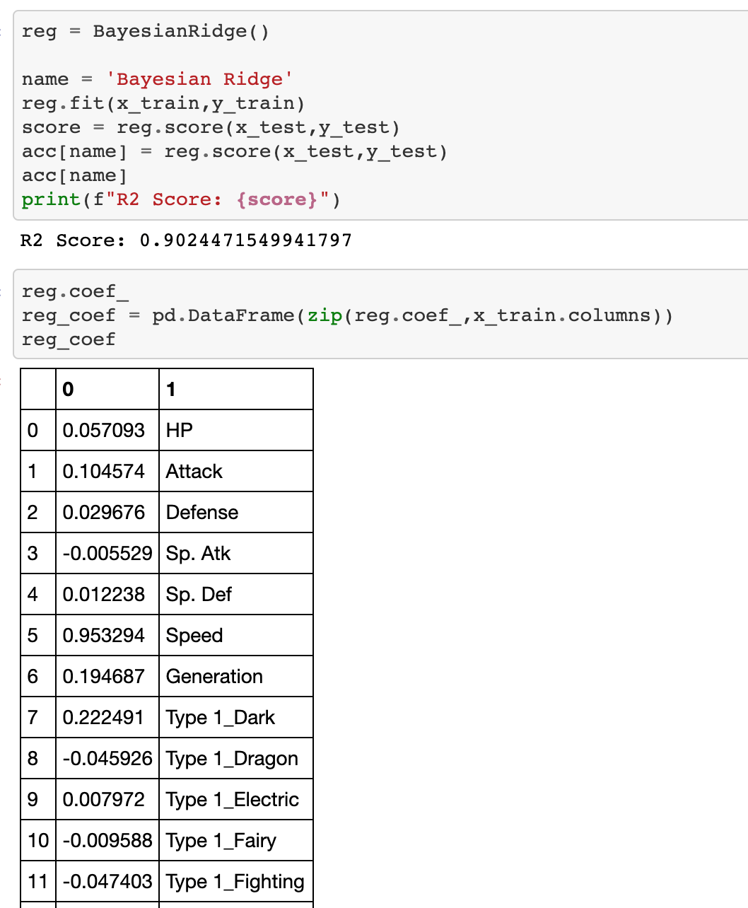
Bayesian Ridge Model
Recommend: Deoxys
Type: Psychic, Legendary
Speed: 180
Attack: 95
Defense: 90
Notes:
Speed is the highest weighted attribute. According to our data, Deoxys would be the best type of Pokemon for Team Rocket based on the Bayesian Ridge Model. However.. It can be quite difficult to catch a legendary pokemon but we have full confidence in our client!

Slide 14
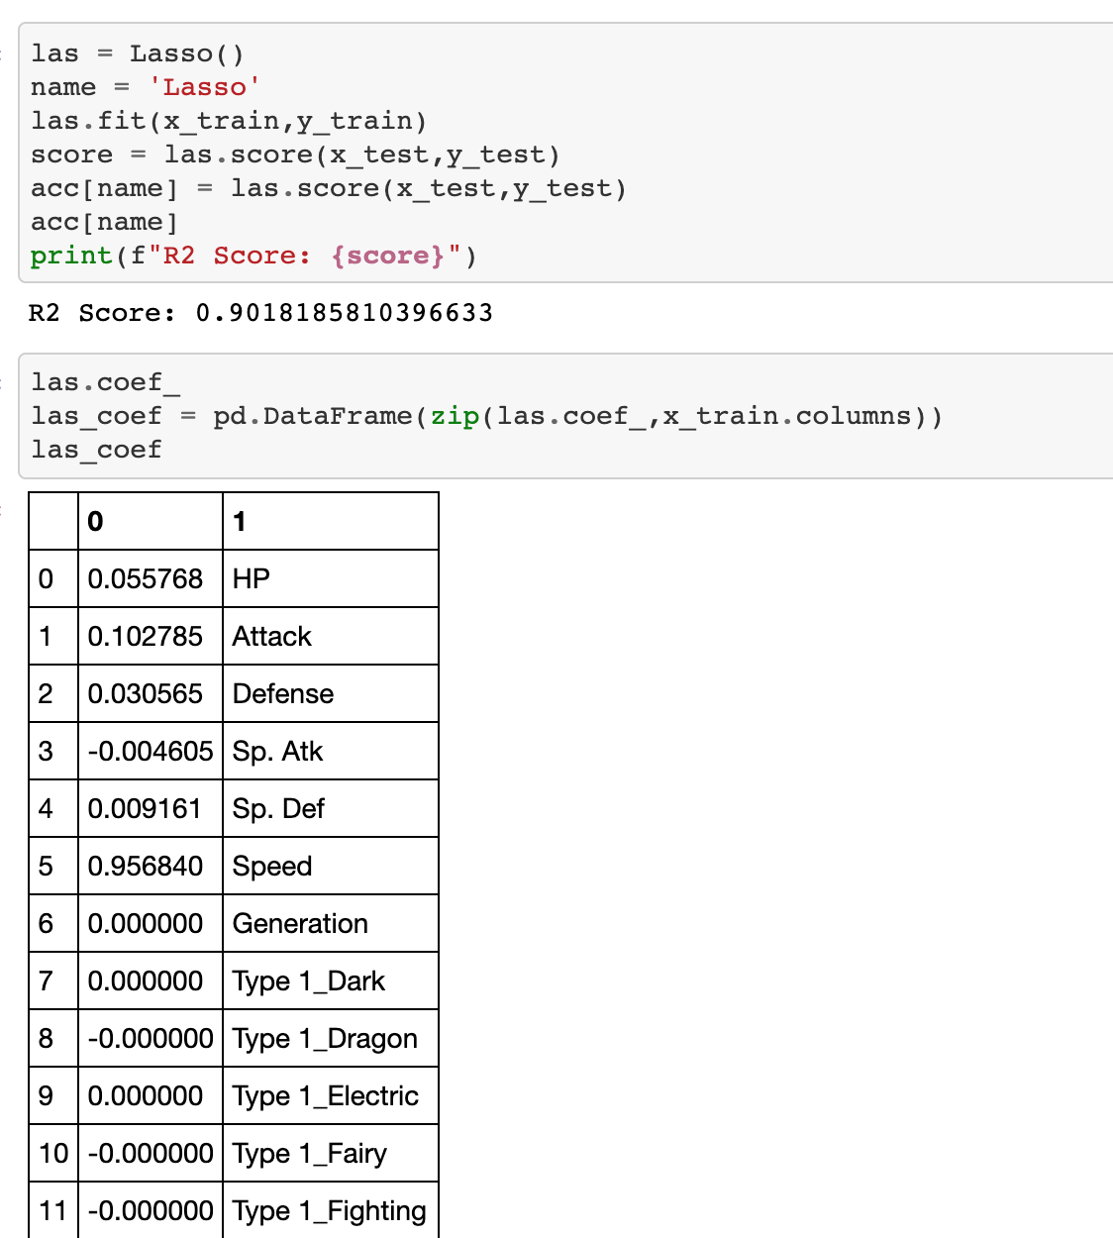

Lasso Model
Recommend: Ninjask
Type: Bug, Flying
Speed: 160
Attack: 90
Defense: 45
Notes:
Speed is also the highest weighted attribute for the Lasso Model. In case our client has some difficulty stealing a legendary pokemon, the next pokemon with the highest speed is Ninjask.

Slide 15
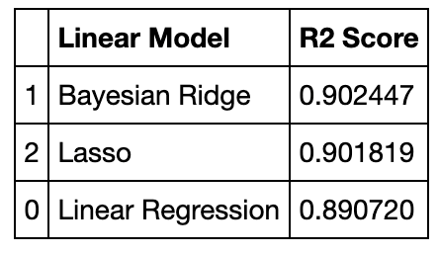
Model Summary

Slide 16

Questions?

